Slide 1
Overestimating vs underestimating
Task A: Estimating with multiplication and addition
1) Identify if the following gives an overestimate, underestimate or if it is hard to determine.
568.5445 + 453. 56 570 + 500 Overestimate
45.215 × 62.123 50 × 60 Hard to determine
5321 × 4236 5000 × 4000 Underestimate
2455 + 2362 × 5466 2500 + 2400 × 5500 Overestimate
0.565 + 0.461 × 0.31 0.6 + 0.5 × 0.2 Hard to determine
953 + 56.56 + 0.665 × 0.6 1000 + 60 + 0.5 × 0.5 Overestimate
56.2² + 54.3² 60² + 50² Hard to determine
2) Here is a calculation
8 467 × 13.92 = 117 860.64
a) Write a multiplication that gives a product close to, but a little more than, 117 860.64
Any values where the multiplier and/or multiplicand have been shifted upwards slightly. E.g. 8500 × 15
b) Write a multiplication that gives a product close to, but a little less than, 117 860.64
Any values where the multiplier and/or multiplicand have been shifted downwards slightly. E.g. 8400 × 10
Task B: Estimating with division and subtraction
1a) Without calculating,
15.99 ÷ 4
is this a little more than 4, a little less than 4 or exactly 4? A little less than 4.
b) Without calculating,
16 ÷ 3.99
is this a little more than 4, a little less than 4 or exactly 4? A little more than 4.

Slide 2
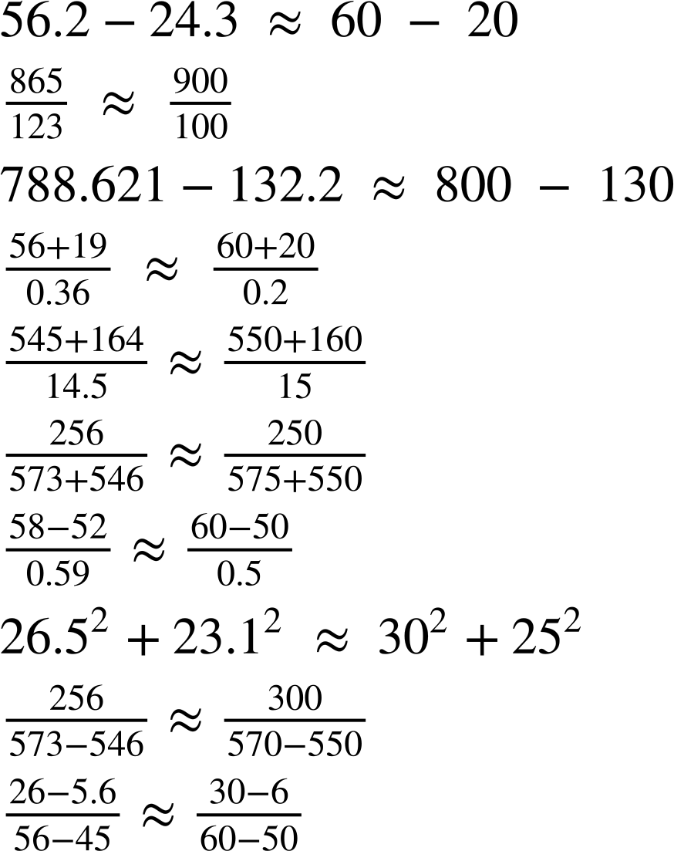
Overestimating vs underestimating
2) Identify if the following gives an overestimate, underestimate or if it is hard to determine.
a)
Overestimate
b)
Overestimate
c)
Overestimate
d)
Overestimate
e)
Underestimate
f)
Underestimate
g)
Overestimate
h)
Overestimate
i)
Overestimate
j)
Hard to tell

Slide 3
Overestimating vs underestimating
Task C: Overestimating vs underestimating in context
The two signs on the left are from different lifts. Each lift can carry a different number of people.
Lift A
Lift B
🠋 G
▲ 4
Max load
8 persons or 630 kg
Capacity 1000 kg
13 persons
a) Which lift assumes that people are heavier?
Lift A assumes people are heavier. A likely estimation might be 640 ÷ 8 = 80 kg for Lift A and 1040 ÷ 13 = 80 kg Lift B. As these give the same answer, the actual weight is closer to 80 for the first lift than it is for the second. The actual assumed weights are 78.75 kg and 76.92 kg (to 2 d.p.) respectively.
b) Which lift is easier to estimate? Why?
Answers can vary. Some may argue that the first lift is easiest, as 630 is close to 640, which is a multiple of 8, so 640 ÷ 80 is a straightforward calculation. You may find the second lift easier may also use the strategy of finding a ‘nearby’ multiplication fact such as 960 ÷ 12 or 1040 ÷ 13.
c) Nine identical boxes are under the weight limit for one lift, but over it for the other lift. What do you know about the weight of the boxes?
The boxes must weigh between 70 kg and approximately 111 kg.
d) Five boxes weighing 23 kg each are put into each lift. Approximately how many people can safely get in the lifts with them?
Answers will depend on how to estimate or calculate with 23. You might take the total weight of the boxes to be 100 (rounding 23 to 20), 115 (using 23) or 125 (rounding 23 to 25). Approximately six people can get into the first lift with the boxes; approximately 11 people can get into the second lift with the boxes.
e) Explain why it is better to overestimate all the scenarios above.
For estimating weight in a lift, it is better to overestimate. If we underestimate, then the lift is in danger of exceeding capacity and breaking.
Mathematics in Education and Industry
v2.3

